Slide 1


SEO Audit
CodingDojo.com

Slide 2


Aside from my day job at Searchmetrics leading & managing global SEO & analytics initiatives for enterprise & fortune 500 companies, I love helping up-and-coming startups with their SEO and online marketing efforts through my own consulting channel SEOSeb.com
I focus on the technical aspect of SEO, as well as semantic content optimization & international targeting thanks to having lived and worked across the pond in Germany, France & Switzerland.
Lastly, I am also a serial evangelist; having spoken at SearchLove Conferences, contribute regularly to the Searchmetrics Blog & hold regular webinars. I was also nominated for a US Search award in 2016.
Sebastien Edgar
sebastienedgar@gmail.com
linkedin.com/in/sebastienedgar
SEOSeb.com

Slide 3
Contents
Organic Market Overview
Competitive Analysis
Content Structure & Optimization
Growth Opportunities

Slide 4
SEO VISION
Become the #1 resource for online coding material
Own online & offline coding Bootcamp classes
Help new coders get the help & information they need

Slide 5
Organic Market Overview
CodingDojo.com

Slide 6
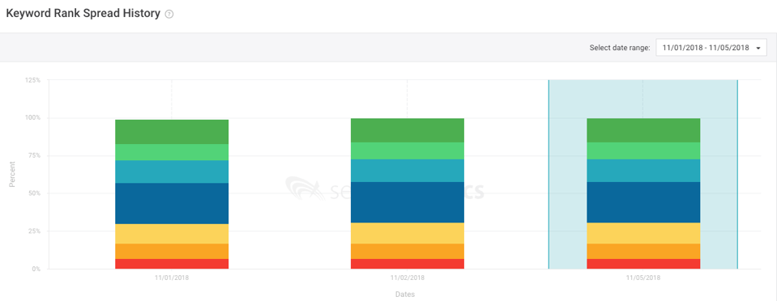
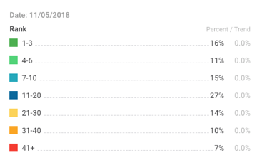
1. Keyword Rank Spread

Slide 7
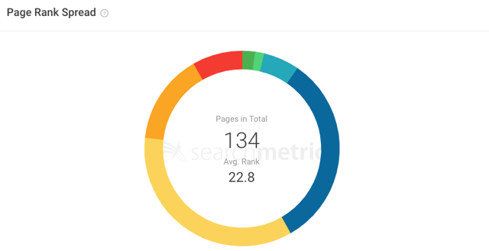
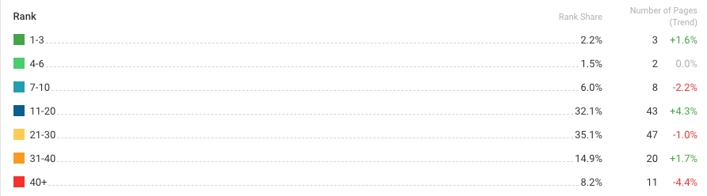
2. URL Rank Spread

Slide 8
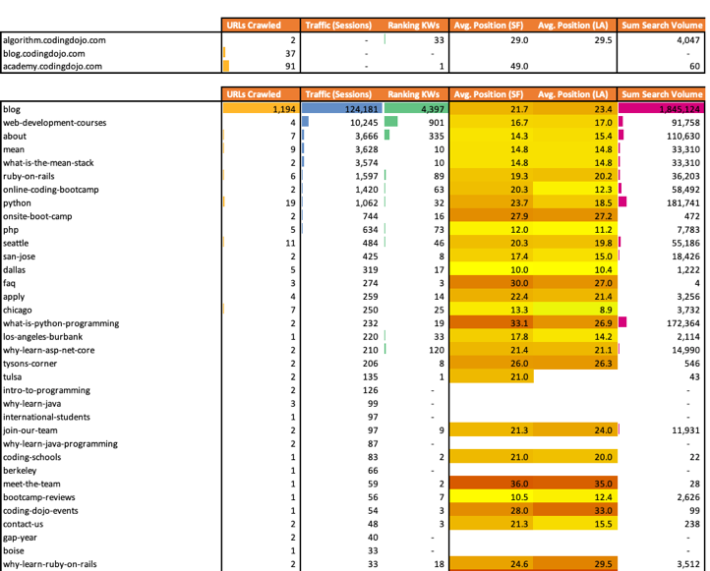
3. Overview Traffic / Rankings
Looking at DIRECTORY → Crawled URLs, Traffic, # Ranking keywords we can see that most of the sessions & ranking keywords are going to the BLOG.
This is not surprising as it caters to the most amount of URLs & long tail keywords.

Slide 9
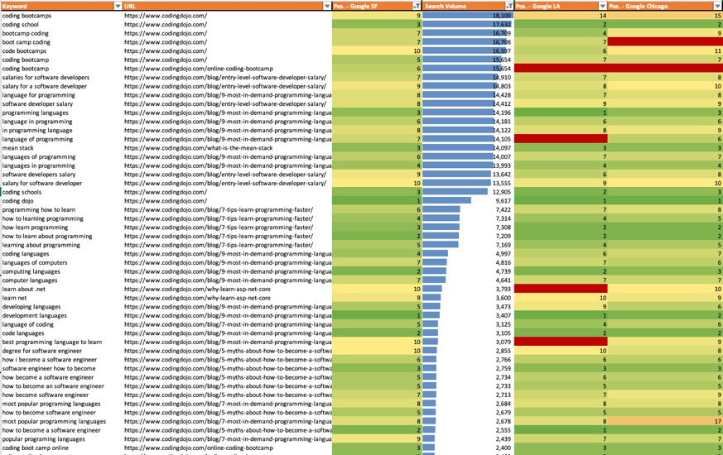
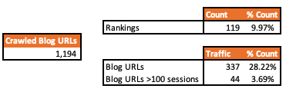
4. Overview Traffic / Rankings

Slide 10
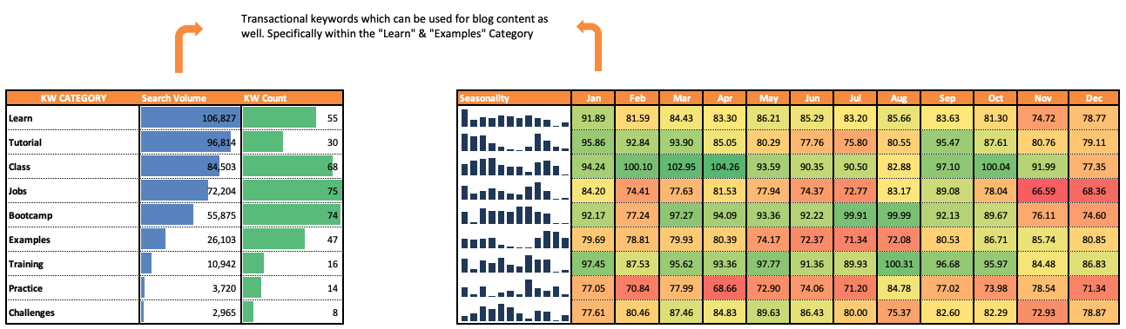
5. Keyword Market Overview – Transactional
Seasonality is also a very important KPI. Looking at the data, keywords are either very highly searched within the winter / fall months or summer.

Slide 11
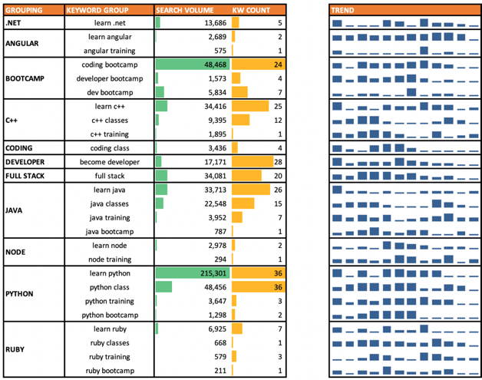
5.1 Keyword Market Overview – Transactional

Slide 12
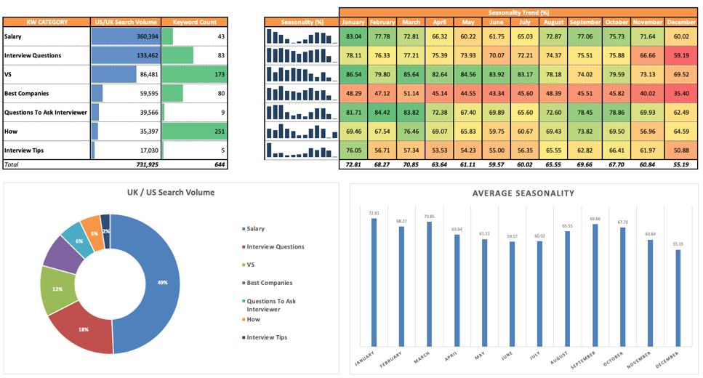
5.2 Keyword Market Overview – Informational

Slide 13
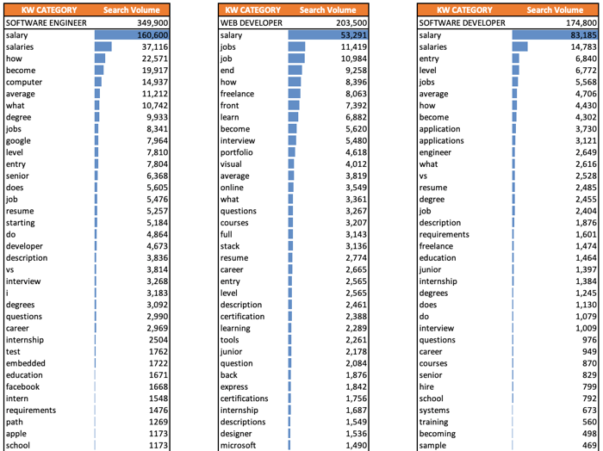
6.1 Keyword Market Overview – Informational

Slide 14
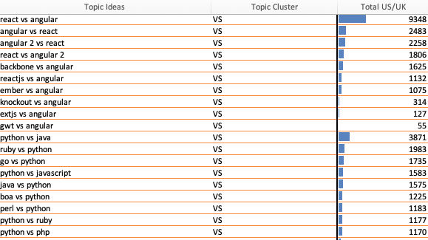
6.2 Keyword Market Overview – Informational (VS.)
One interesting market is comparison: {topic 1} vs. {topic 2}
These can yield a series of interesting blog or guide articles catering to these topics.

Slide 15




Competitive Analysis

Slide 16
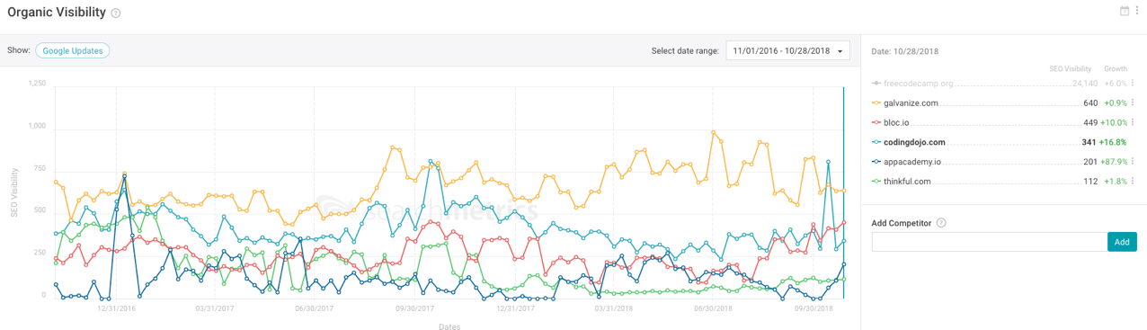
1. Competitive Landscape - Visibility

Slide 17
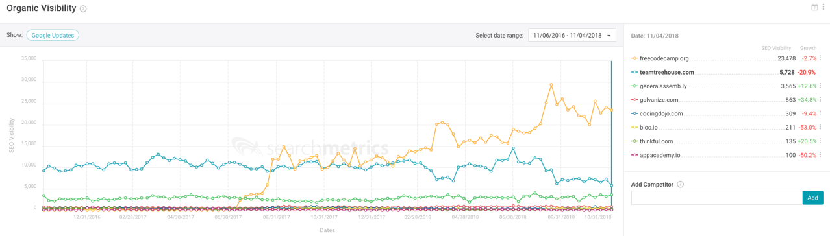
1.1 Competitive Landscape - Visibility

Slide 18
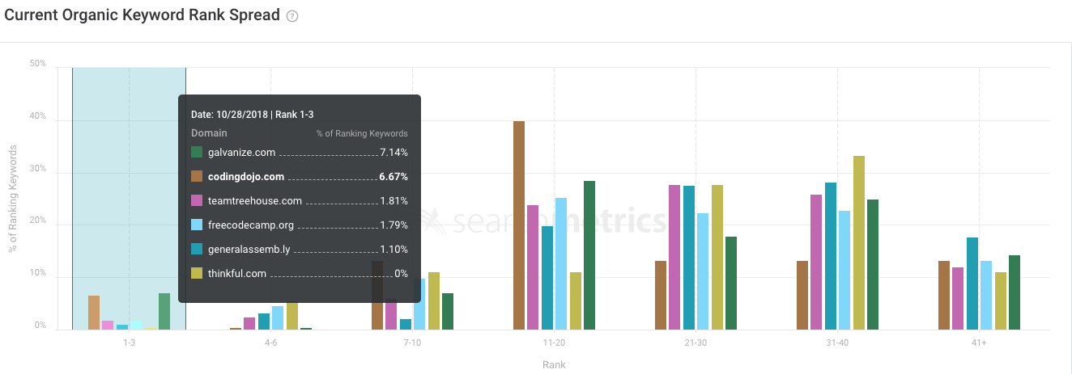
1.2 Competitive Landscape – Organic Keyword Rank Spread

Slide 19
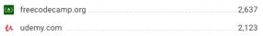
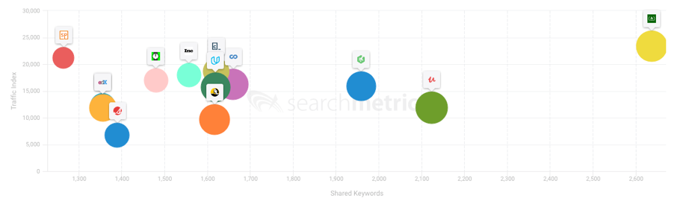
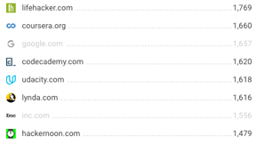
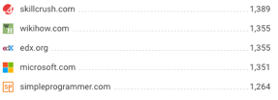
2. Competitive Landscape – Closest Organic Competitors
Shared Keywords

Slide 20

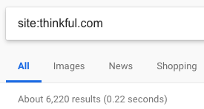
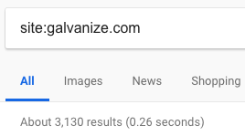
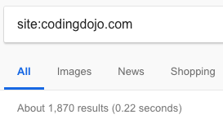

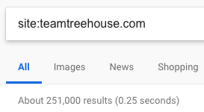
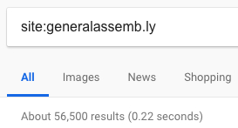
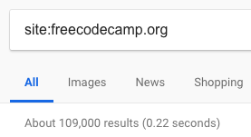
3. Number of indexed pages

Slide 21
4. Competitive Analysis – Shared Keywords - Explanation
Shared Keyword Count
Shared Keywords: Percentage shared keywords between CodingDojo & Competitor
Unique Keywords_CD: Percentage of unique keywords for CodingDojo
Comp. Unique KW: Percentage of unique keywords for competitors
Shared Keyword Traffic
Traffic_CD: CodingDojo’s traffic from the keywords being shared with competitor
Comp. Traffic: Competitor traffic from the keywords being shared with CodingDojo

Slide 22
4.1 Competitive Analysis – Shared Keywords

Slide 23
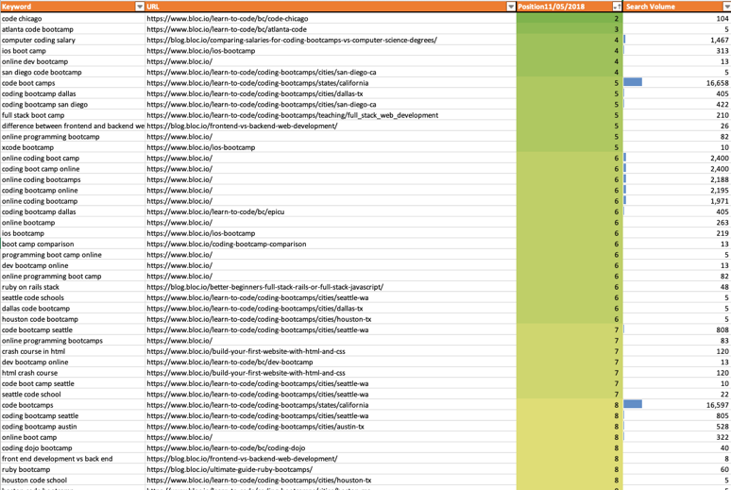
5. Competitive Analysis

Slide 24

4.2 Competitive Analysis – Shared Keywords

Slide 25
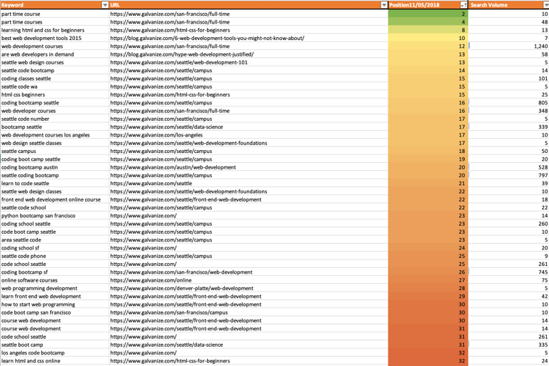
5. Competitive Analysis

Slide 26

4.3 Competitive Analysis – Shared Keywords

Slide 27
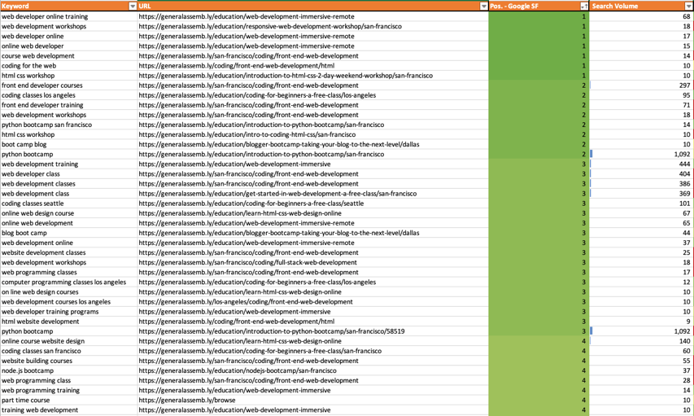
5. Competitive Analysis

Slide 28

4.3 Competitive Analysis – Shared Keywords

Slide 29
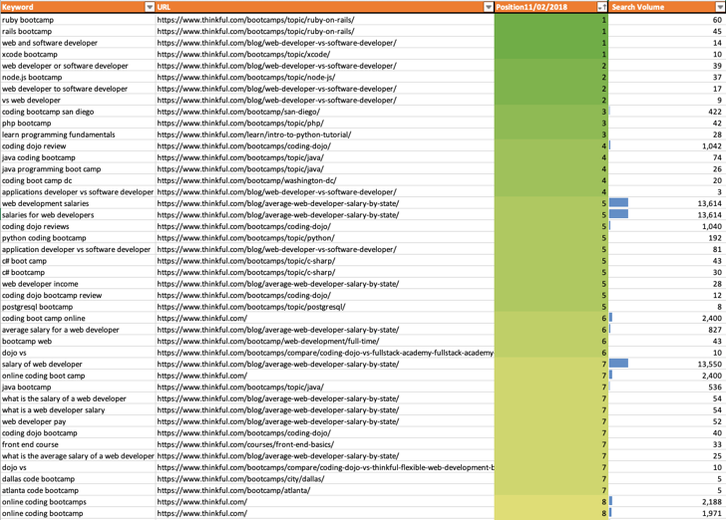
5. Competitive Analysis

Slide 30
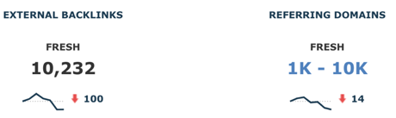
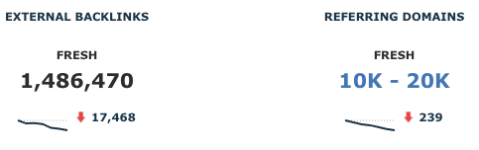

6. Backlink Analysis – Total Links

Slide 31
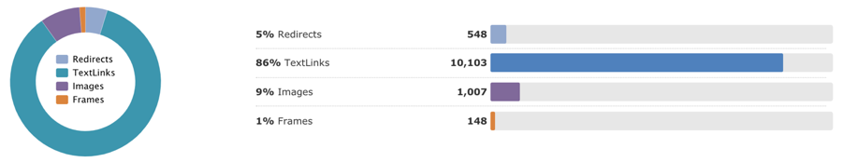
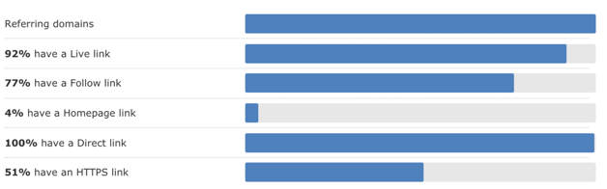
6.1 Backlink Analysis - Profile

Slide 32
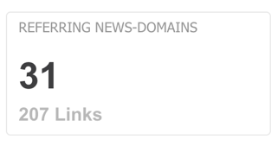
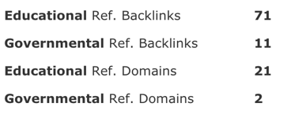
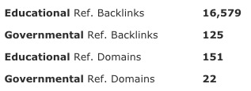
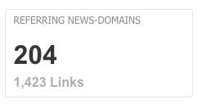
6.2 Backlink Analysis – Authoritative Links

Slide 33
Technical SEO Analysis
CodingDojo.com

Slide 34
1. Duplicate Pages
URL | Page Strength | Incoming Links
https://www.codingdojo.com/why-learn-java | 1.1 | 7
https://www.codingdojo.com/why-learn-java-programming | 5.1 | 58
https://www.codingdojo.com/why-learn-python | 1.1 | 7
https://www.codingdojo.com/what-is-python-programming | 5.3 | 72
https://www.codingdojo.com/curriculum | 1.1 | 1
A few duplicate pages of the same content seem to exist.
In order to minimize search engine confusion, it is best to consolidate these pages & only link one version throughout the site.

Slide 35
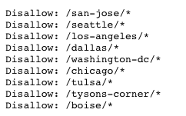
2. Robots.txt (part 1)
Currently, all subpages within each cities are being blocked in robots.txt.
Eventually, we will want to remove this in to target more keywords & pages within each location.

Slide 36
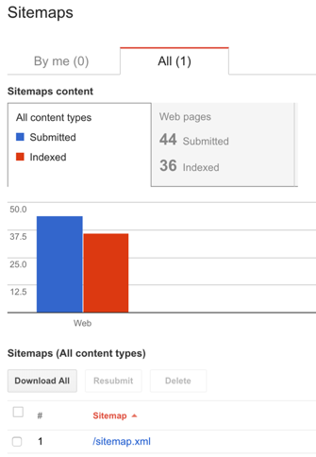
2. Sitemap Optimization (.XML)
Since CodingDojo does not have billions of pages in the index, we can work with a simple sitemap layout.
Sitemaps will be divided in 2 core sections:
Blog sitemap
Location & courses URLs sitemap
Once these have been created, add those within Google Search Console

Slide 37
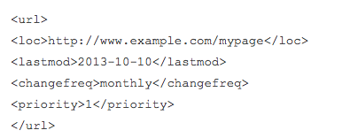
2.1 Sitemap Optimization Best Practices
URL Location
Date of when pages was last modified
How often this page changes (Daily, Weekly, Monthly, Yearly)
Crawling Priority (0.0, 0.1, 0.2, 0.3, 0.4, 0.5, 0.6, 0.7, 0.8, 0.9, 1.0)
Sitemaps should be in an XML format
Elements outside of URL location are not important, Google barely takes them into consideration. However, they are still recommended just in case.

Slide 38
3. Sitemap Optimization (.HTML)
An HTML sitemaps allows Google to view all important URLs in one place
Additionally, it helps users search engines with dividing link juice across the site more efficiently.
It also provides some user experience benefits to also allow users to view these pages
The HTML sitemap should be linked from the sitewide footer

Slide 39
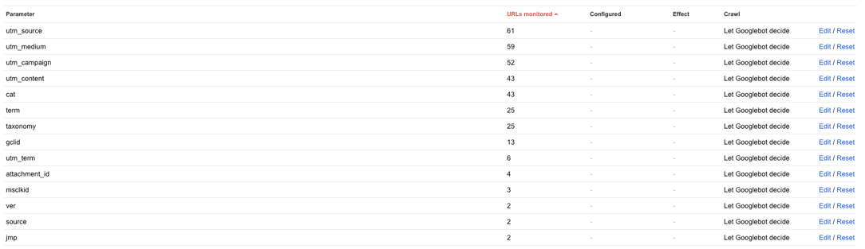
4. URL Parameters
Configuring URL parameters in Google Search Console is always advisable.
Even though canonicals are setup, Google does not always respect those, configuring URL parameters helps with an extra layer of security to minimize crawl & index leakage.

Slide 40
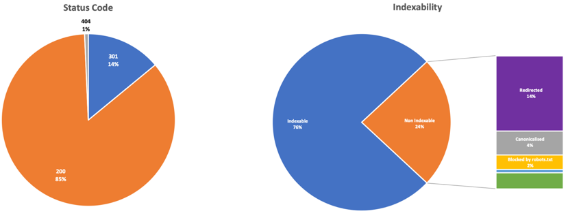
5. Internal Redirect & Indexability
From an indexability / Redirect standpoint, things look healthy.
However does still a few internet 301s which should be minimized.
Each 301 loses around 10% link Juice (authority)

Slide 41
5.1 Internal Redirect & Indexability

Slide 42
5.2 Internal Redirect & Indexability

Slide 43
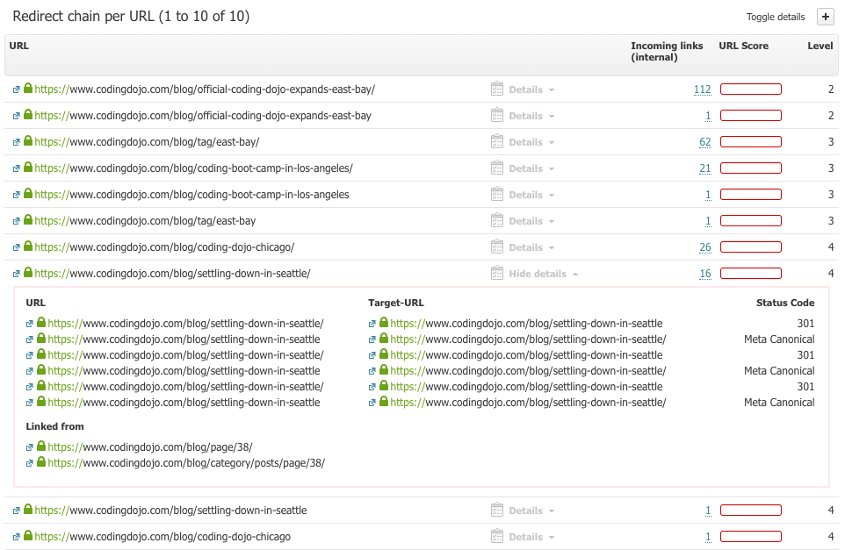
5.3 Redirect Chains
Similarly, when crawling CodingDojo.com, there were around 10 urls which “redirect chains”: 301 mismatching the canonical.
This is mostly due the “trailing slash” giving mixed signals.

Slide 44
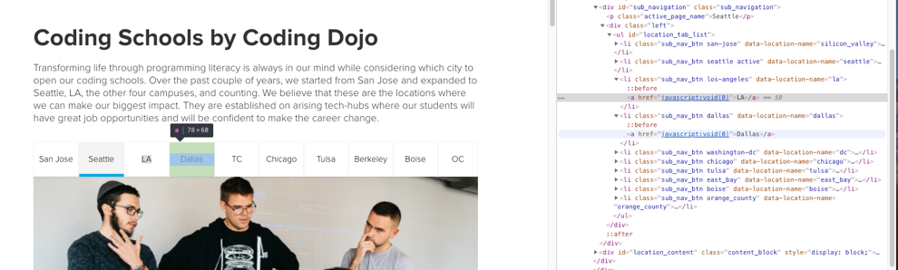
6. JavaScript Void
Utilizing “JavaScript:void(0)” for tabbed content is not advisable. Since JS requires a user interaction, Google is unable to “see” each link & thus view content behind each tab.
For tabbed content, it is best to use CSS “display:none”. Since Google view page loads initially without styling, it is able to crawl & render all content behind tabs.

Slide 45
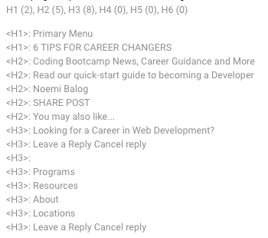
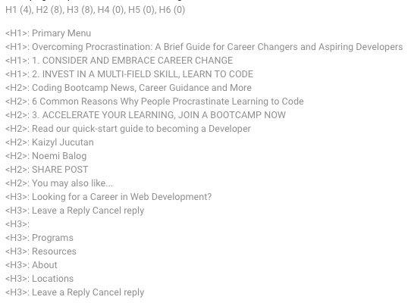
7. H-tags Optimization
https://www.codingdojo.com/blog/6-tips-for-career-changers/
https://www.codingdojo.com/blog/overcoming-procrastination-brief-guide-career-changers-aspiring-developers/

Slide 46
8. Internal Linking
Internal linking is one of the most important strategies in SEO:
Important pages receiving many links should link out to other high potential pages in order to let the link juice flow.
Linking out better to pages which have a high potential.

Slide 47
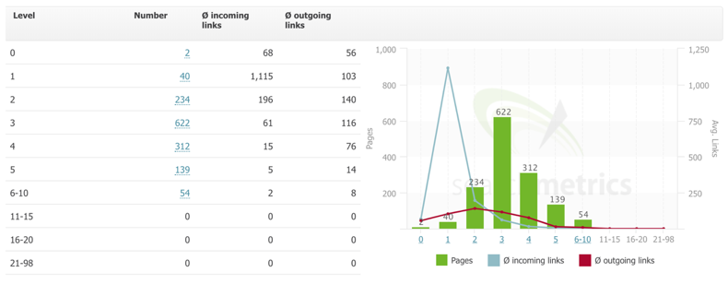
8. Internal Linking
Looking at the crawl path, the internal linking layout looks fairly healthy:
There are not too many pages beyond level 5
Some internal links go beyond level 2, though this could be improve
Ratio of outgoing links isn’t too high

Slide 48
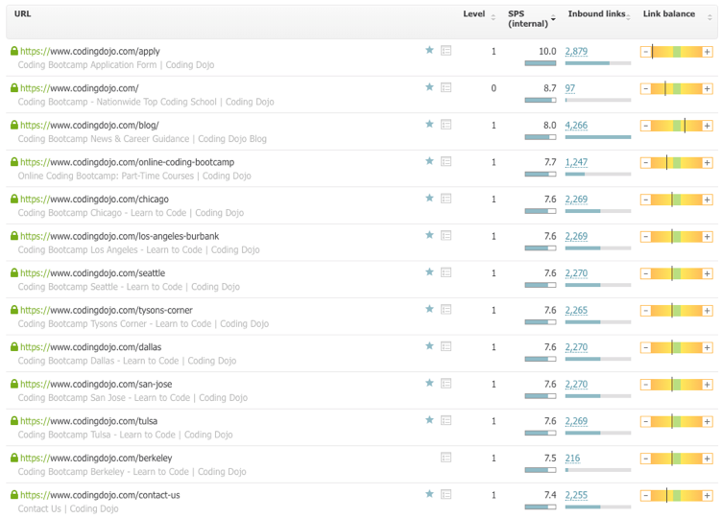
8.1 Top linked pages
Regarding the top linked pages, things are actually very positive.
Those most linked are the most important ones.

Slide 49
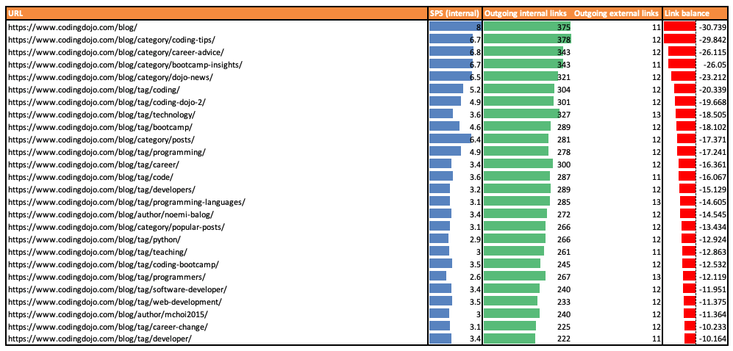
8.2 Internal Linking - Pages with too many outbound links
Looking at pages which have too many outbound internal links i.e. wasting internal link juice - we mainly notice the blog category pages.
Given that these are not priorities for SEO, this is not something to worry about at the moment.
However, one initiative would be to increase links to these pages.

Slide 50
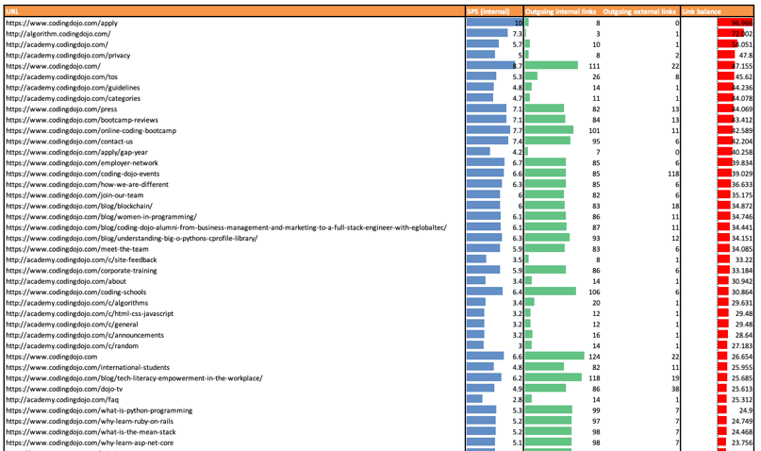
8.3 Internal Linking - Pages with too few outbound internal links
Conversely, looking at pages which have too few outbound internal links i.e. pages needing more links going out.
What this data tells us is that is that most internal pages have the ability to accommodate more links.

Slide 51

9. Site Speed Improvements – HTTP/2 Migration
Currently, it looks like CodingDojo.com is running on HTTP/1.0.
Migrating server over to HTTP/2.0 can offer tremendous efficiency & site speed improvements.
In some cases, total load times can be halved.

Slide 52
9.1 Site Speed Improvements – HTTP/2
Benefits:
HTTP/2 is Binary (Browser natural language).
It is fully multiplexed, sending multiple requests in parallel over a single TCP connection.
It uses header compression HPACK to reduce overhead.
It allows servers to “push” responses proactively into client caches instead of waiting for a new request for each resource.
It uses the new ALPN extension which allows for faster-encrypted connections since the application protocol is determined during the initial connection.
It reduces additional round trip times (RTT), making your website load faster without any optimization.
Domain sharding and asset concatenation is no longer needed with HTTP/2
Next steps:
Check if NGINX server & other site elements are compatible with HTTP/2.
If yes, starting HTTP/2 migrating phases are recommended.
http://searchengineland.com/everyone-moving-http2-236716

Slide 53

Desktop Site Speed Analysis

Slide 54

10. Site Speed – Desktop - Homepage
Websites with a higher site (lower time to first byte & total time until rendered) rank higher than those taking longer to load

Slide 55


10.1 Site Speed – Desktop
https://www.codingdojo.com/why-learn-java-programming

Slide 56


10.2 Site Speed – Desktop
https://www.codingdojo.com/berkeley

Slide 57



11. Mobile Friendliness

Slide 58
Content Structure & Optimization

Slide 59

1.1 Optimize Homepage Content

Slide 60

1.2 Optimize “Online Coding Bootcamp”

Slide 61

1.3 Optimize Local “Seattle” Coding Bootcamp

Slide 62

1.4 Optimize “Why Learn Python”

Slide 63


2. Direct Answers Opportunity
From a list of ~6k relevant keywords that CodingDojo currently ranks for ~12% (730) return a direct answer integration

Slide 64

2.1 Direct Answers Targeting
ON-PAGE CONTENT FACTORS
Flesch-Kincaid readability
Word count
Presence of <ol> or <ul> lists (Bullets & lists)
Presence of <table>
Presence of search query in <title> tag
Presence of search query in <h1>
TECHNICAL SEO
Presence of Schema.org code snippets
Response time and page speed

Slide 65
2.2 Direct Answers Targeting
SNIPPET URLS TYPICALLY HAVE:
<table> tags 22% more often than non-snippet URLs
<ol> tags 42% more often
19% faster response times
Slightly higher word counts
Slightly easier readability scores
Slightly higher link metrics
Schema.org markup 20% less often.
(Exact match keywords in <title> 10% more often)
(Exact match keyword in <h1> and <h2> 21% more often)

Slide 66
2.3 Direct Answers Targeting
Structured Data (rich snippets) helps Google understand the various items of information on a page.
The Trust / Authority of a domain are critical: If the domain has links to relevant pages on the subject and/or itself is linked by other quality pages, it then gains trustworthiness and authority in the respective subject area from Google’s point of view.
Pages with structured content, for example by means of subheadings, bullet points or with numbered lists offer a good user experience.
Such content can be more easily scanned and understood by Google.
It is correspondingly easier for Google to select a relevant section for Direct Answers from the website in question.

Slide 67
Growth Opportunities

Slide 68


1. Intent Organization
Looking at intent of the ~6k keyword, we notice that Google has classified most keywords as informational.
However, “coding bootcamp” does that transactional tendencies.

Slide 69
1.1 Intent Organization - Structure
Ruby on Rails
Transactional
“Bootcamp…”
“Courses..”
“Classes…”
Informational
“What is…”
“How to…”
“Learn…”
CodingDojo needs to cater to both intents: Transactional & Informational
To ensure that there are no intent disparity & confusion for Google, we need to ensure we have pages for both intents.

Slide 70

1.2 Informational Market – “Learn Python”
Mainly tutorials & articles.
Informational queries rarely have transactional items

Slide 71


1.3 Transactional Market – “Python Bootcamp”
However, transactional queries occasionally have informational websites included in the SERPS.

Slide 72




1.4 Calendar & Enhanced SERP

Slide 73

1.5 Calendar & Enhanced SERP
Utilizing this calendar to help with Structured Data Markup (schema.org) is recommended.
However, more unique data is needed such as course titles & location for each dates.
https://developers.google.com/search/docs/data-types/event

Slide 74
2. Location Structure
Locations
San Francisco
.Net Core
Python
Ruby
Mean
Java
It is recommended to utilize geo-targeting & a differentiation in courses in order to target the most amount of keyword variety as possible.
However, if badly implemented, it could lead to large scale duplicate content issues
To ensure content uniqueness, additional elements are required on each pages:
Reviews (UGC) – Star markup benefit in SERP
Instructor details
Dynamic internal links
E.g. resources links

Slide 75

2.1 Location Structure
Need unique content before disallow
Locations
San Francisco
.Net Core
Python
Ruby
Mean
Java

Slide 76

3. Community Section
Pros | Cons
Expand keyword reach | High ranking volatility
User retention | Negative results if mismanaged
Internal / External Linking | Thin content / crawl bloat

Slide 77


4. Job Board
Even though there is high search volume for the job market, at least ~50k for individual job keywords, the market is extremely saturated & competitive due to sites like Indeed, Glassdoor, etc.…

Slide 78

4.1 Job Board
Even Google know makes it tougher to enter the market…

Slide 79
Thank you!

